Slide 1
Review of previous classes
1. Nanotechnology in upward motion: next future of science and technology is nanotechnology
2. Constructive - Destructive interference by thin films
3. Non-Reflective Surfaces
4. Super-Hydro-Phobicity
5. Self-Cleaning
Nano in Histroy
The Localized Surface Plasmon Resonance
DICHROISM
Development of nanoscience and technology
Diversity of nano field
Surface to volume atoms of Cuboctahedral system
M(K) = (1/3)*(10K³+15K²+11K+3), K = No. of shell
N_{K} =10K² + 2, Every shell contains number of shell
SIZE EFFECT
Quantum Effect
To-Down Method of Preparation
Ball mill, Thermal, Arc discharge, Laser ablation etc.
LITHOGRAPHIC METHOD
Bottom-UP method
HOW TO REALIZE THE NANOPARTICLE ?
TEM
SEM

Slide 2
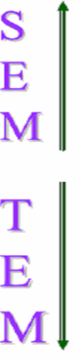
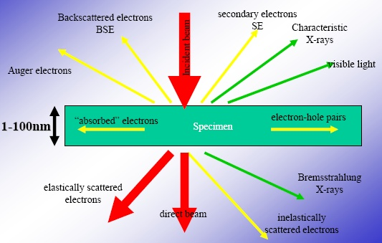
Interaction between electrons and specimen
The interaction generates a lot of signals which can be used in scanning electron microscopy (SEM) and transmission electron microscopy (TEM)

Slide 3
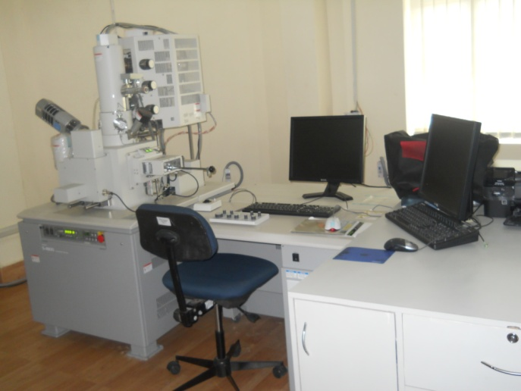

Slide 4
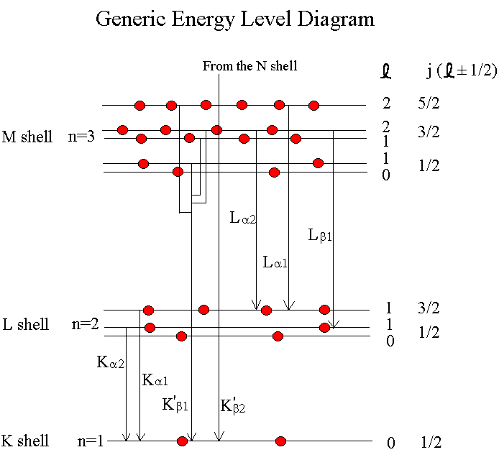
Thus an x-ray spectrum will also show characteristic x-rays arising from L to K and M to K transitions after ionization of a K electron
Usually transitions to higher shells absorbed by the filtration or are not x-rays

Slide 5
Scanning Electron Microscope
The SEM functions much like an optical microscope but uses electrons instead of visible light waves.
The SEM uses a series of EM coils as lenses to focus and manipulate the electron beam.
Samples must be dehydrated and made conductive.
Images are black and white.

Slide 6
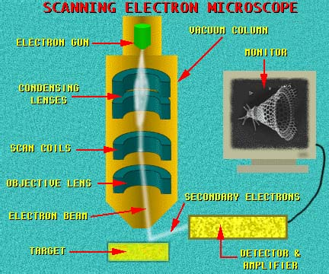

Slide 7
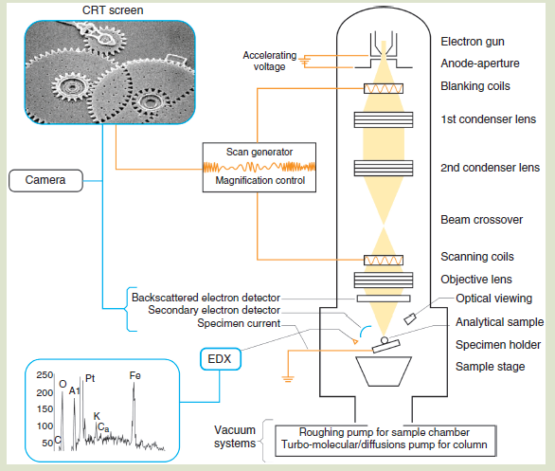

Slide 8
OPERATION
There are two major challenges with operating an SEM
Creating an image requires correctly establishing different parameters
Interpreting the resulting image also requires a lot of skill and experience
Other than that, it’s really easy!

Slide 9
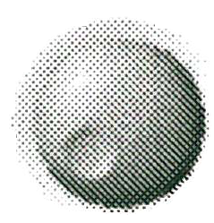
Imaging Inputs (operator controls)
20
15
25
100
200
40
60
40
60
10
30
50
500
20
80
20
80
5
35
100
100
1
10
1000
0
0
kV
probe current
brightness
contrast
25
20
30
1,000
10,000
24
45
15
35
100
100,000
6
90
10
40
1,000,000
5
10
1.6
180
working distance
magnification
dwell time

Slide 10
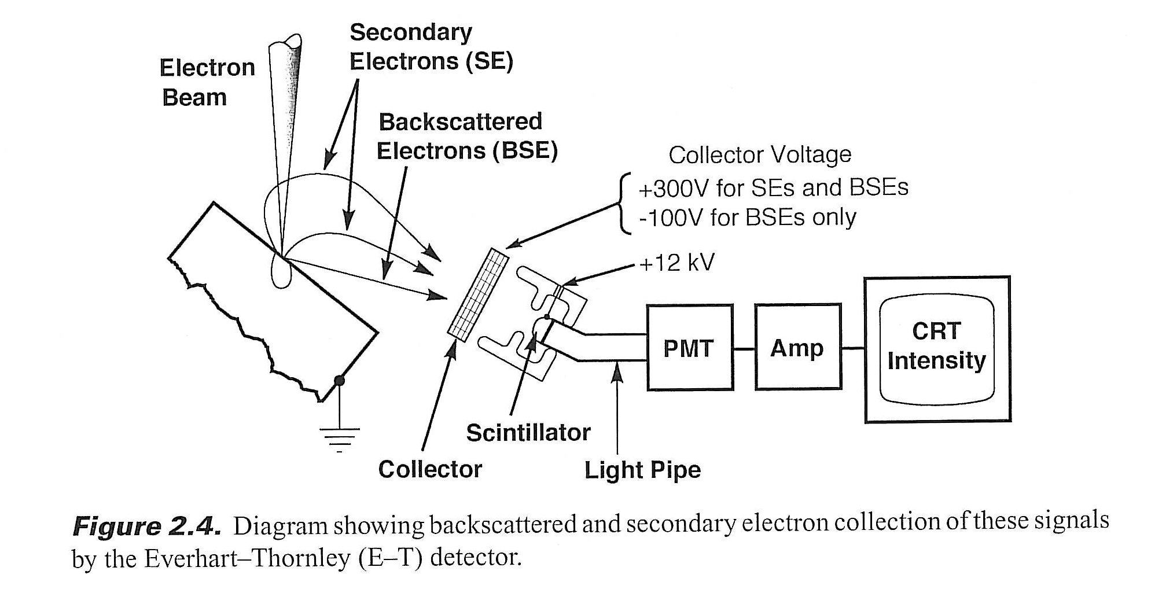

Slide 11
Imaging modes
Resolution: gives maximum resolution!
High current: for optimum contrast, EDX and EBSD
Depth of focus: large depth of field is a great attribute of the SEM. Use long working distance
Low voltage mode
Better topographic information
Ability to overcome charging

Slide 12
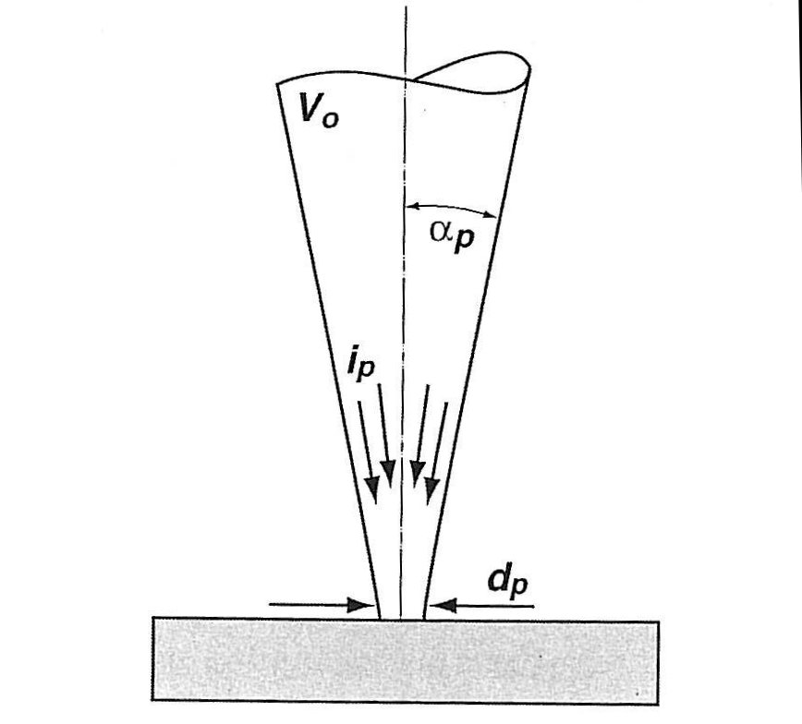
Parameters Determining Resolution
Accelerating potential: V₀
Probe current: I_{p}
Beam diameter: d_{p}
Convergence angle: α_{p}

Slide 13
Currents in an SEM (W-filament)
Filament current: Current that heats a tungsten filament, typically 2.6-2.8 A. Strongly affects filament lifetime. Similar for Schottky FEG, but only heated to 1700 K
Emission current: total current leaving the filament, typically about 400 μA for W-filament, 40 μA for FEG.
Beam current: Portion of emission current that transits the anode aperture; decreases going down the column.
Probe current: a calculated number related to the current on the sample, typically 10 pA – 1 nA.
Specimen current: the current leaving the sample through the stage, typically about 10% of the probe current. Remember that one electron incident on the sample can generate many in the sample…a 20 keV electron can generate hundreds at 5 eV.
FEI also defines a parameter called “spot size” which is proportional to the log₂(probe current); proportionality constant depends on aperture size.

Slide 14
Electron sources/guns: options
The requirements for modern SEMs call for nanometer resolution, high current into small probe sizes, and effective low voltage operation
Such needs make the venerable thermionic gun obsolete for top of the line SEMs
So all high performance SEMs now use some more advanced form of electron source
W-filament machines are still much less expensive and adequate for many applications

Slide 15
WHEN DO WE NEED WHICH KIND OF SEM?
The FEG SEM offers high performance not just high resolution
This means large probe currents (up to a few nanoamps, [I_{p} goes to 5 μA] important for EDS and EBSD), and small diameter electron probes (from 1 to 3nm), over a wide energy range (from 0.5 -30keV).
The FEG SEM performance package involves both the gun and the probe forming lenses
Huge difference in resolution between FEG and W-filament at very low voltage
A FEG SEM will cost about twice as much as a W-filament machine

Slide 16
Tungsten Hairpin Filaments
The electron source is the key to overall performance
The long time source of choice has been the W hairpin source
Boils electrons over the top of the energy barrier - the current density J_{c} depends on the temperature and the cathode work function  f- Richardson’s equation…..
J_{c}=AT²exp(-e/kT)
Cheap to make and use ($12.58 ea) and only a modest vacuum is required. No vac-ion pump. Last tens of hours.
Thermionic electrons
Schematic Model of Thermionic Emission

Slide 17
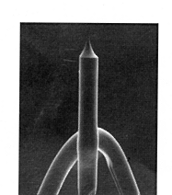
Cold Field Emitters (FEG)
Electrons ‘tunnel out’ from a tungsten wire because of the high field obtained by using a sharp tip (100nm) and a high voltage (3-4kV)
J_{c}=AF²/φ.exp(-Bφ^{1.5}/ F)
The Fowler-Nordheim equation shows that the output is temperature independent – hence the name ‘cold’
Needs UHV but gives long life and high performance

Slide 18
Flashing: required of cold-FEGs, not Schottky thermal field emitters
Each tip should show a consistent emission current when it is flashed
Compare the tip current with its own usual value not with that from other tips
If the value is low, flash several times until the current recovers
Excessive flashing may blunt the tip

Slide 19
Cold FEG Gun behavior
The tip must be atomically clean to perform properly as a field emitter
Even at 10⁻⁶ Torr a monolayer (“one Langmuir”) of gas is deposited in just 1 sec so the tip must be cleaned every time before it is used; tip needs 10⁻¹⁰ Torr
Cleaning is performed by ‘flashing’ - heating the tip to white heat for a few seconds. This burns off (desorbs) the gas
Typical characteristics
The tip is usually covered with a mono- layer of gas after 5-10 minutes
The emission then stabilizes for a period of from 2 hours (new machine) to 8 hours (mature machine).
Tip must be re-flashed after 8-12 hours of operation (the machine gives you a warning)

Slide 20
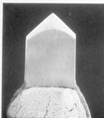
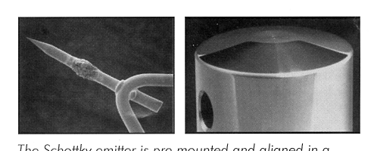
Schottky Emitters
In the Schottky emitter the field F reduces the work function f by an amount - Df = 3.80E-4 F^{1/2}eV
Cathode behaves like a thermionic emitter with
f* = f-Df
The cathode is also enhanced by adding ZrO₂ to lower the value of f
Lifetime ~ 2 years kept hot and running
Df
ZrO₂ dispenser
Schottky Emission

Slide 21
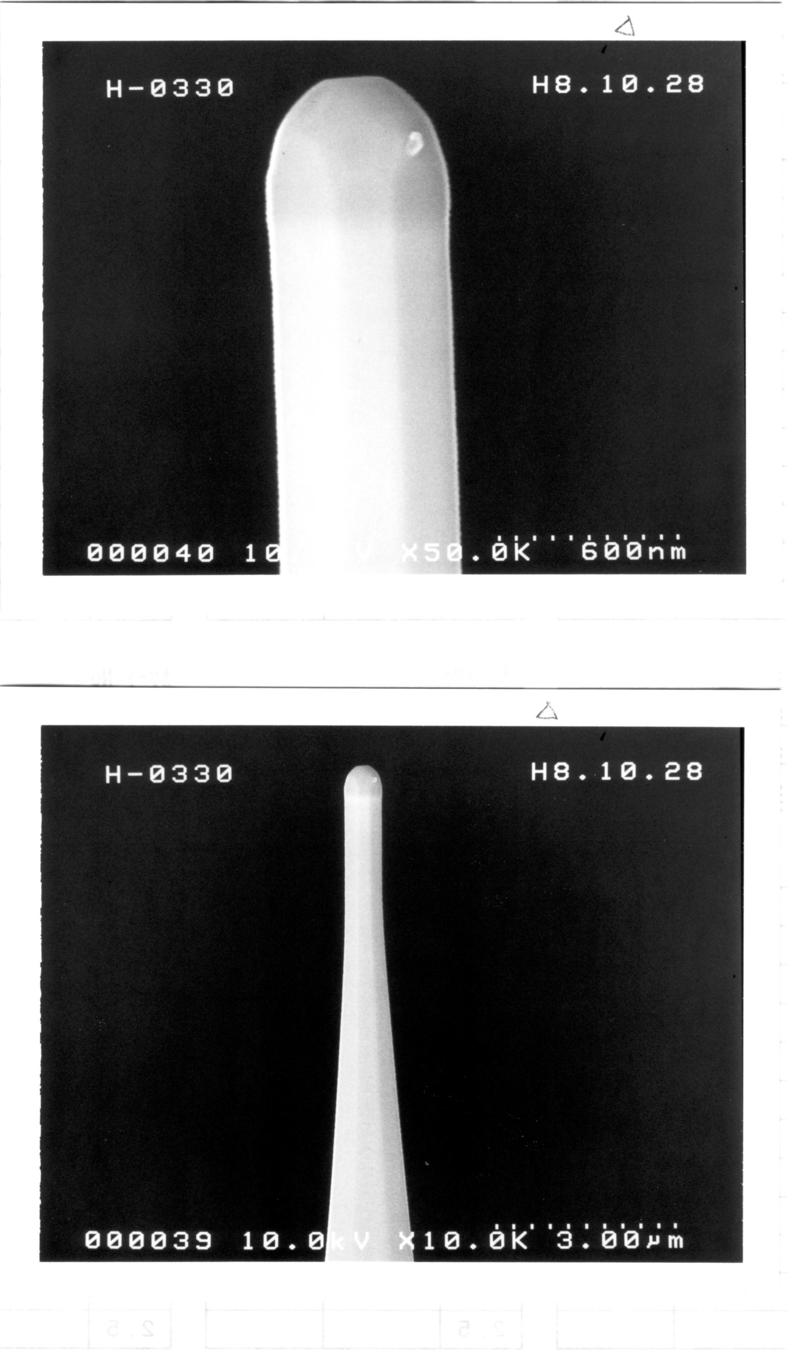
The Schottky Emitter
The Schottky source runs at ~1750K
It is not a field emitter – despite what other companies tell you - because the tip is blunt and if the heat is turned off there is no emission current
A Schottky is a Field Assisted Thermionic Source
Hitachi Schottky Emitter Tip

Slide 22
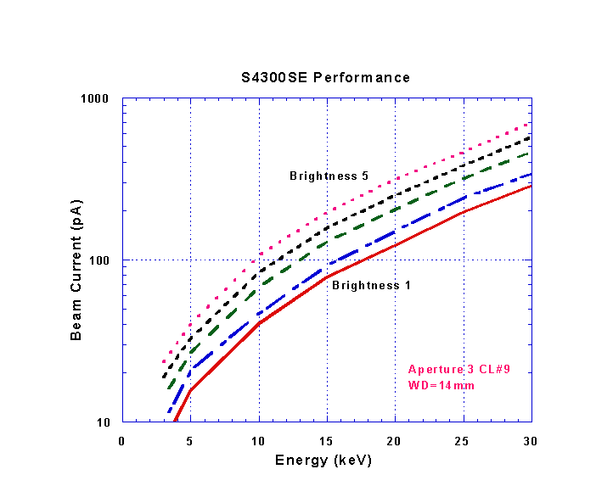
Schottky Performance
Schottky emitters can produce large amounts of current compared to cold FEG systems; cold FEGs are less useful for EDS and not good for e-beam lithography.
Because they are always on they are very stable (few % per week change in current)
They eventually fail when the Zirconia reservoir is depleted: 1-2 years.
Output from Schottky gun

Slide 23
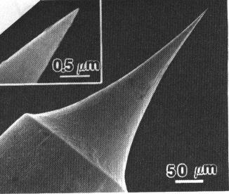
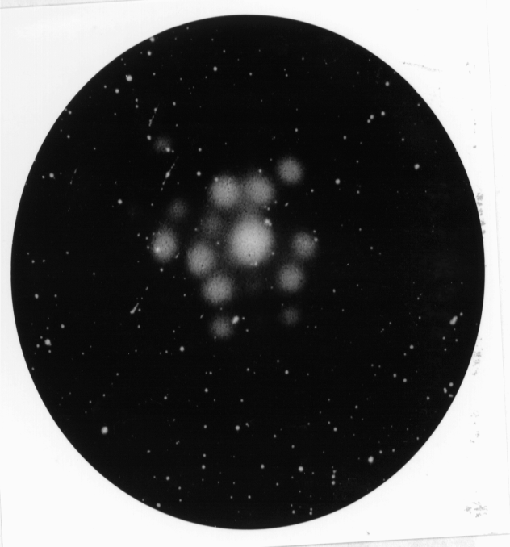
Nano tips - atomic sized FEG
Nano-tips are field emitters in which the size of the tip has shrunk to a single atom.
They can be made by processing normal tungsten FE tips
More usually they are made from carbon nanotubes
They can operate at energies as low as 50eV, and have a very small source size
Etched tungsten tip
Field ion image of a W nanotip emitter

Slide 24
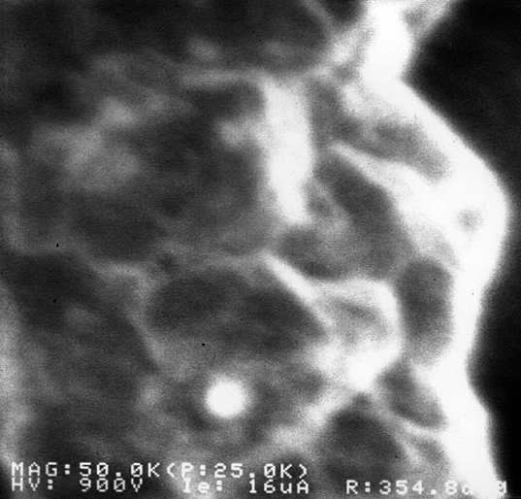
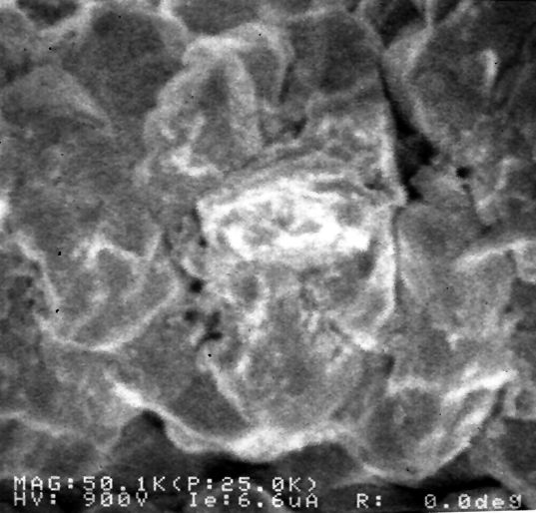
Regular and Nano Tips
Regular tip
Nano tip
Copper alignment grid sample in S6000 CD-SEM
Courtesy A. Vladar, NIST

Slide 25
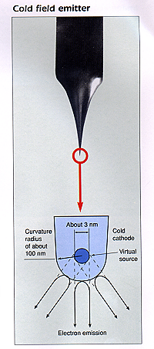
(1) Source Size
The source size is apparent width of the disc from which the electrons appear to come
Small is good - for high resolution SEM because less demagnification is needed to attain a given probe size
But too small may be bad – because demagnification helps minimize the effects of vibration and fields
W hairpin - 50µm
Schottky - 25nm
Cold FEG - 5nm
Nano-FEG - 0.5nm
The physical size of the tip does not determine the source size!

Slide 26
Brightness
Luminance is a photometric measure of the density of luminous intensity in a given direction. It describes the amount of light that passes through or is emitted from a particular area, and falls within a given solid angle. “Brightness” is a term which has been supplanted by “luminance”.
L_{v} = d²F/(dA dΩ cosθ)
Where:
L_{v} is the luminance or brightness
F is the flux of radiation or electrons
dA is the area on the source or detector
dΩ is the solid angle subtended by the detector
Θ is the angle between the direction the radiation is going and the normal to the detector area

Slide 27
(2) Source Brightness
Brightness :current per unit area per solid angle; has units of amp/cm²/steradian
Brightness is conserved
Also increases linearly with voltage
Measuring b at the specimen

Slide 28
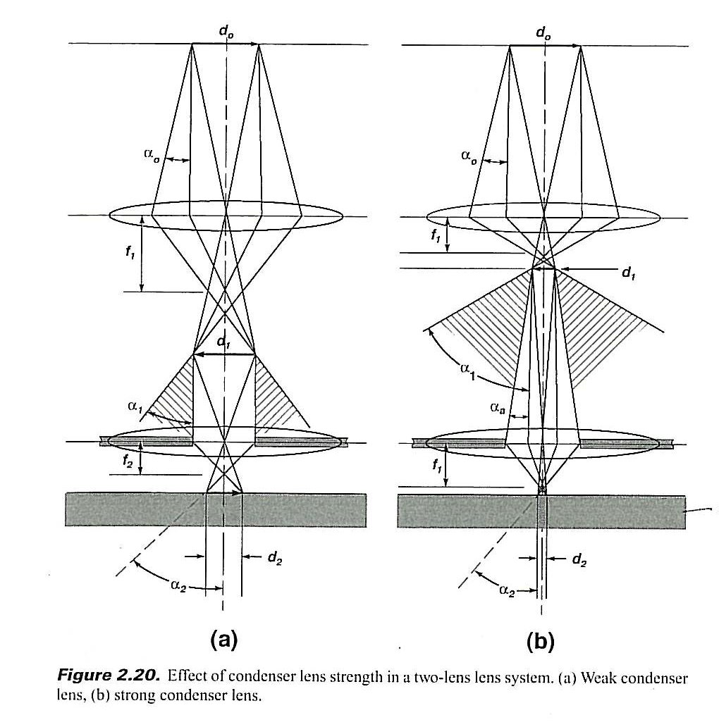
Conservation of brightness
Strong condenser lens:
Smaller beam area
Tighter focus
More electrons apertured
Out by final aperture
Weak condenser lens:
Larger beam area
Less tight focus
Fewer electrons apertured
out by aperture
Sample

Slide 29
Emitter brightness
Brightness is the most useful measure of gun performance
Brightness varies linearly with energy one so must compare different guns at the same beam energy
High brightness is not the same as high current
At 20keV typical values (A/cm²/str)
W hairpin 10⁵
FEGs 10⁸
nano-FEG 10¹⁰

Slide 30
Comparison of Electron Sources at 20kV
 | Units | Tungsten | LaB₆ | FEG (cold) | FEG (thermal) | FEG (Schottky)
Work Function | eV | 4.5 | 2.4 | 4.5 | - | -
Operating Temperature | K | 2700 | 1700 | 300 | - | 1750
Current Density | A/m² | 5*10⁴ | 10⁶ | 10¹⁰ | - | -
Crossover Size | μ m | 50 | 10 | <0.005 | <0.005 | 0.015-0.030
Brightness | A/cm² sr | 10⁵ | 5 × 10⁶ | 10⁸ | 10⁸ | 10⁸
Energy Speed | eV | 3 | 1.5 | 0.3 | 1 | 0.3-1.0
Stability | %/hr | <1 | <1 | 5 | 5 | ~1
Vacuum | PA | 10⁻² | 10⁻⁴ | 10⁻⁸ | 10⁻⁸ | 10⁻⁸
Lifetime | hr | 100 | 500 | >1000 | >1000 | >1000

Slide 31
The cold FEG offers high brightness, small size and low energy spread, but is least stable, generates limited current and must be flashed daily.
But Schottky emitters are stable, reliable, and have most the best features of cold FEG and the familiar tungsten hairpin source
Nanotips may be the source of the future if the bugs can be worked out
W-hairpins are adequate for many applications not demanding highest resolution.

Slide 32
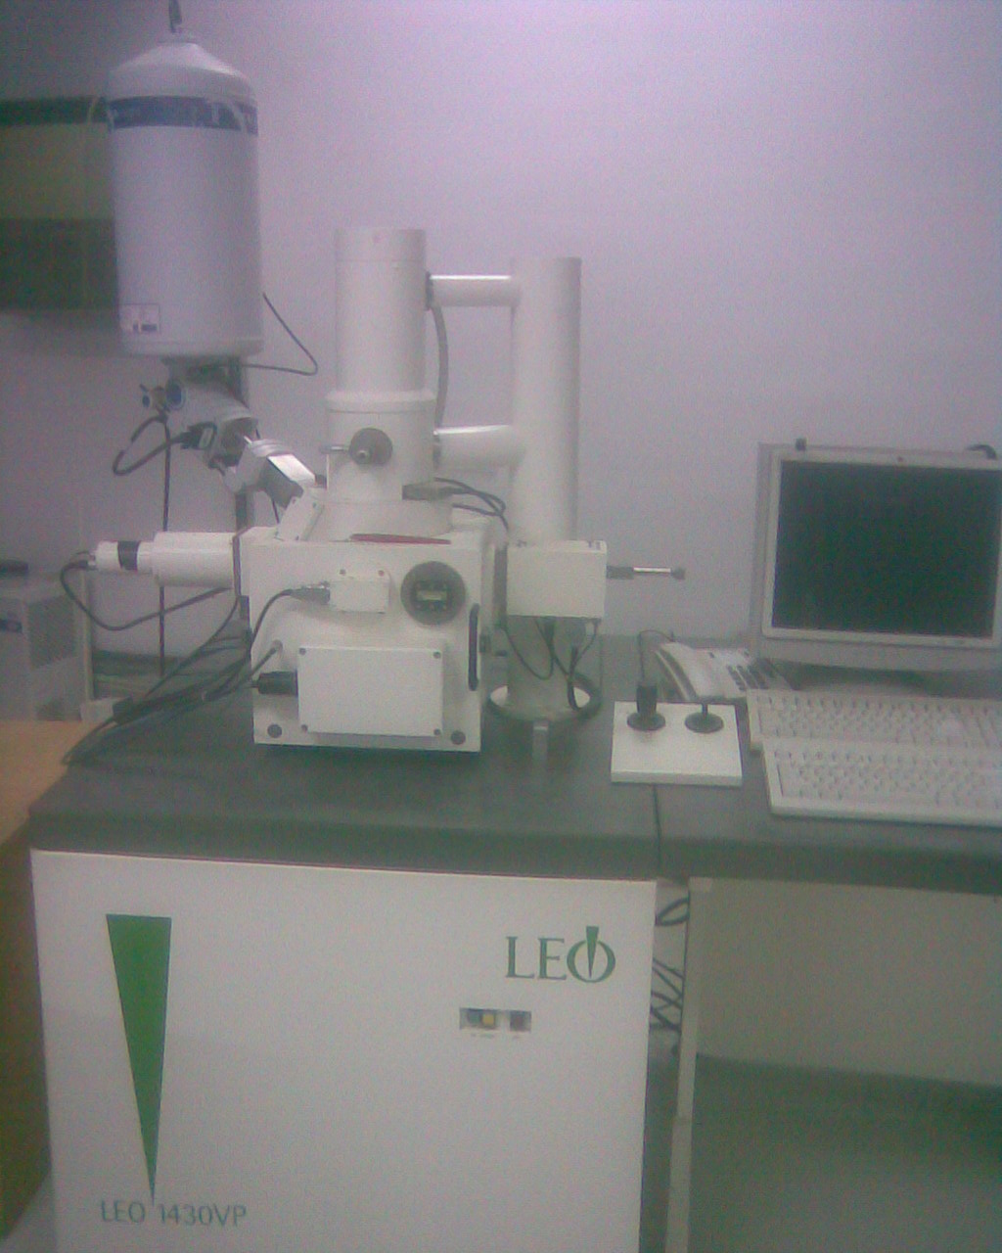
Leo 1430vp

Slide 34
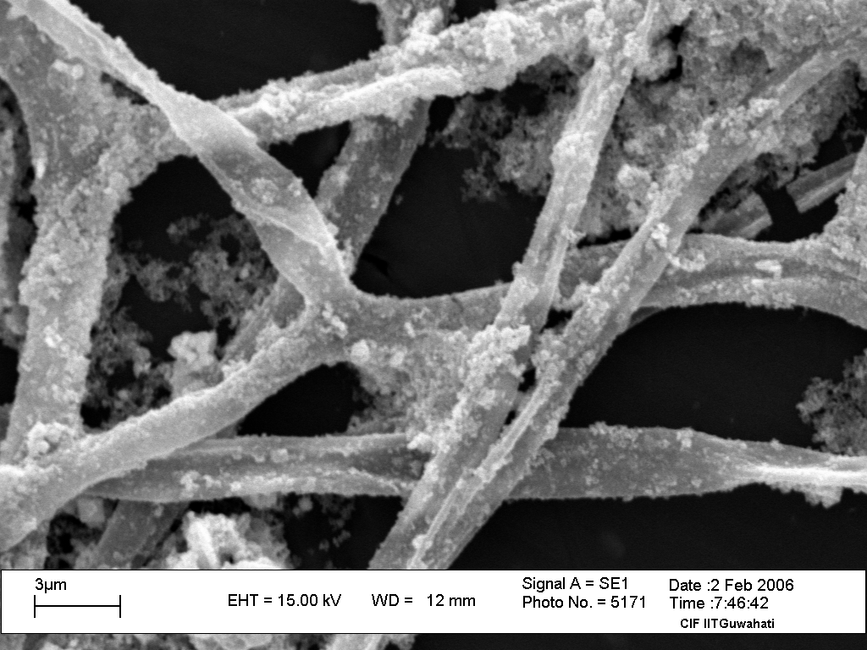
Fibers

Slide 35
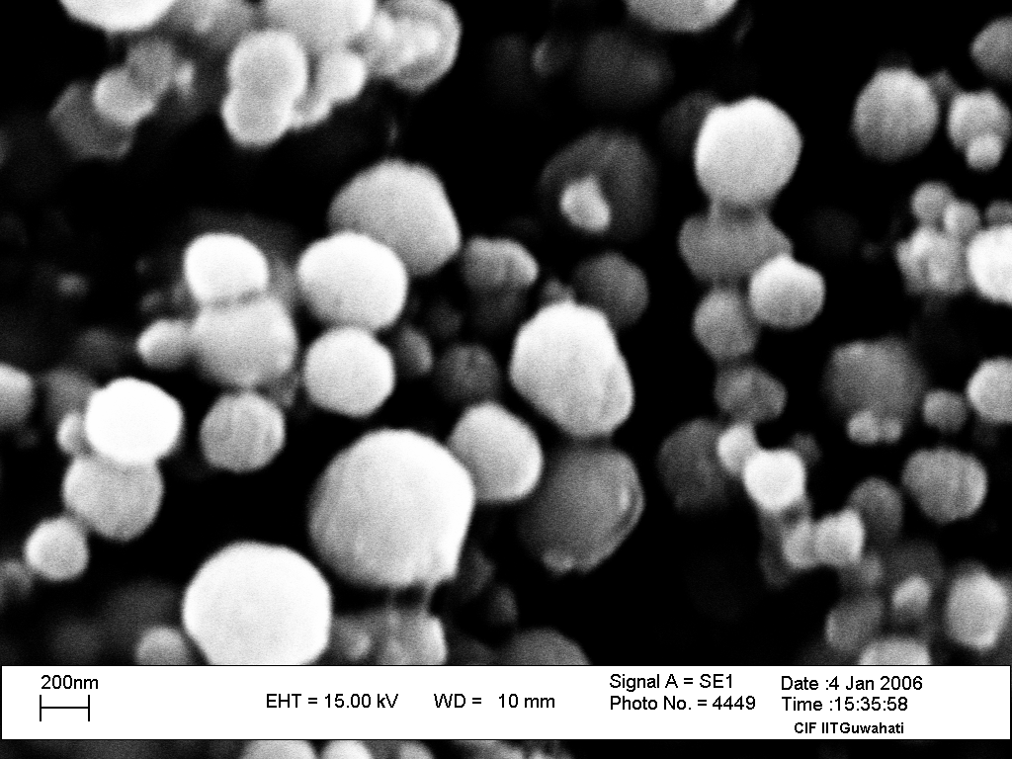
CdS

Slide 36
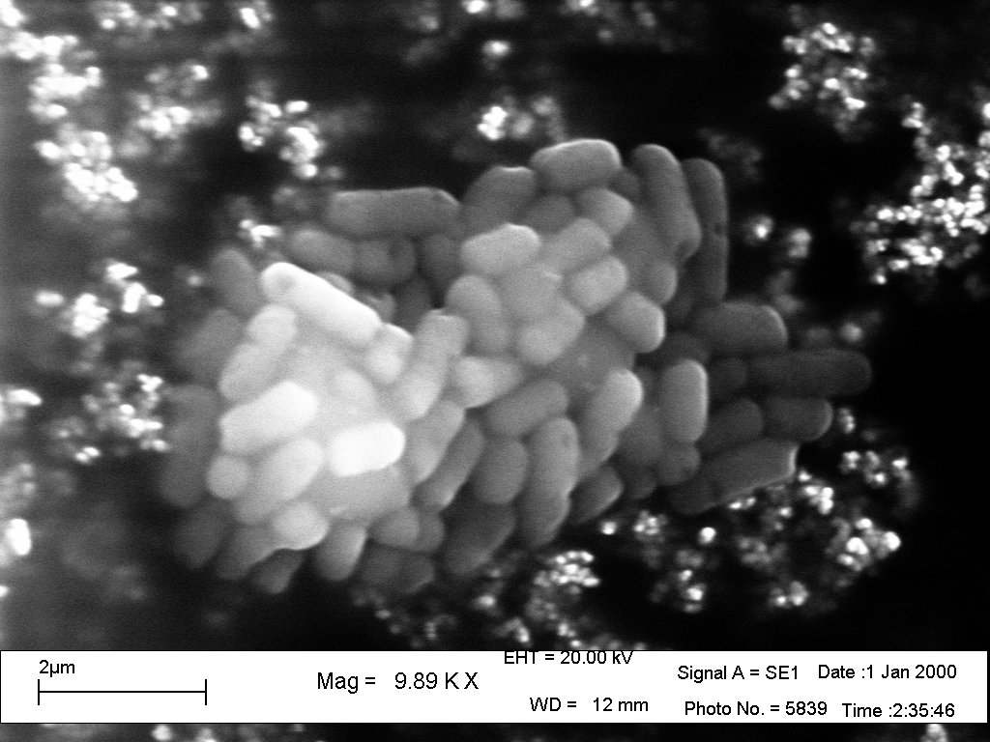
Bacteria

Slide 37
Ascorbic Acid: Vitamin C

